Slide 1
House price prediction Machine learning model deployment using Heroku
Team:
Vinod Vijayaraghavan
Karthik Ashok
Mohammed Althaf
Saravanan Balasubramanian

Slide 2
Introduction
The purpose of this project is to touch on every aspects of a machine learning model from data gathering to deployment. Model is trained using the famous Boston housing dataset.
By deploying the model, we hope it will be actually useful for real life use. We will be using Heroku for deployment, as it is one of the simplest app hosting platforms.

Slide 3
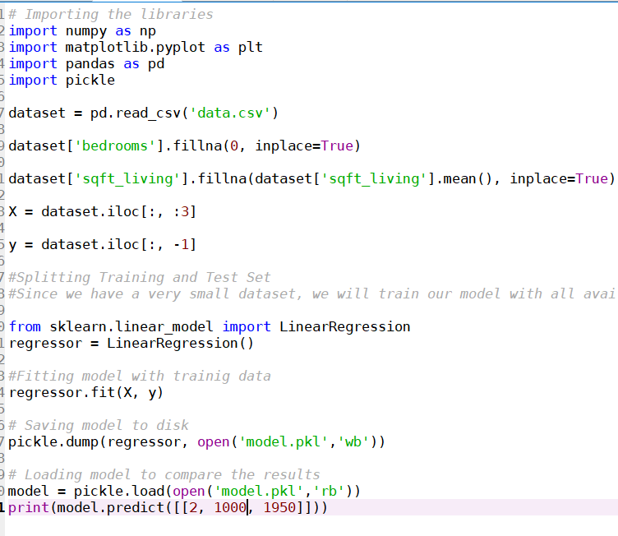
Step 1 – Model Training

Slide 4
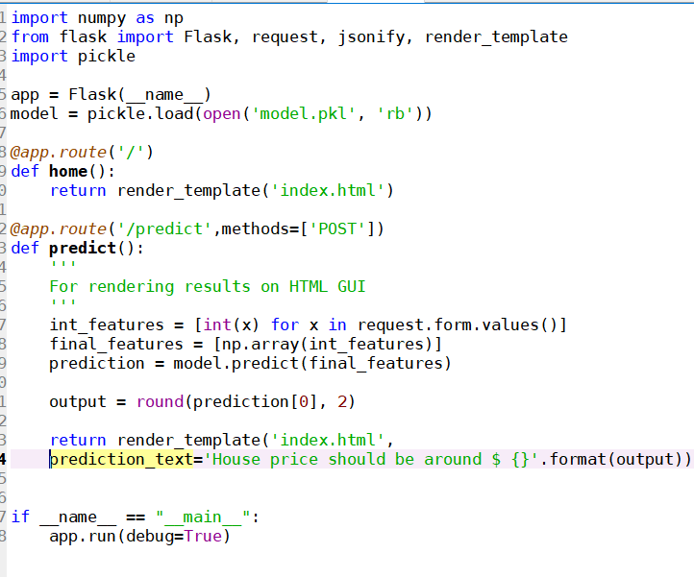
Step 2 – Create webapp using flask

Slide 5
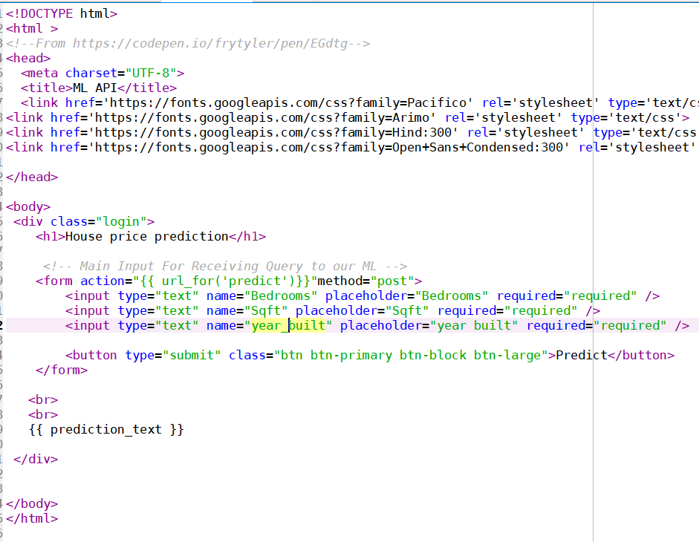
Step 3 – UI creation using HTML

Slide 6
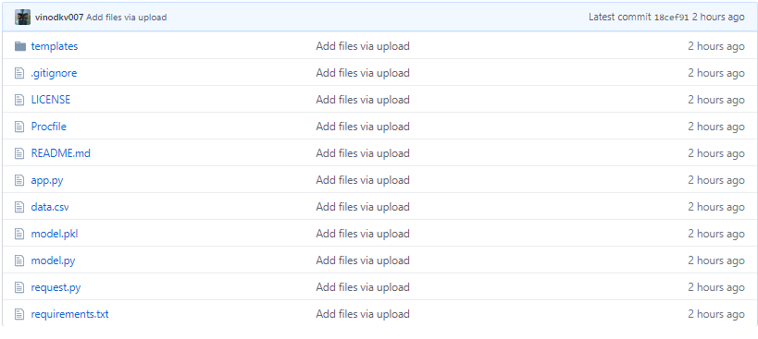
Step 4 – Commit the code in github
https://github.com/vinodkv007/Deployement

Slide 7
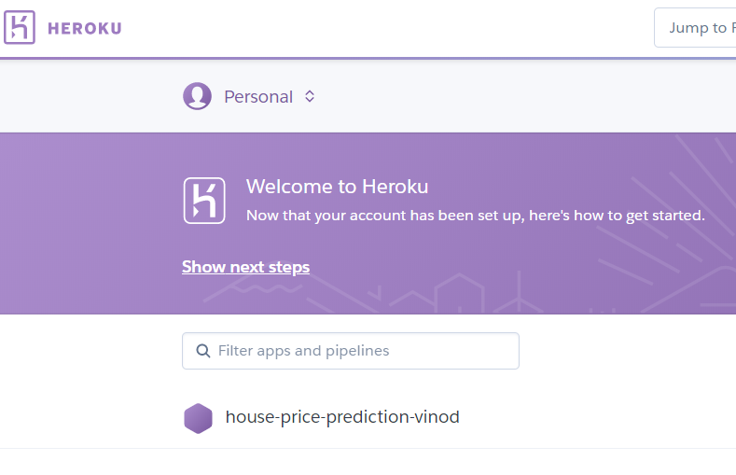
Step 5 – Create an account in Heroku

Slide 8
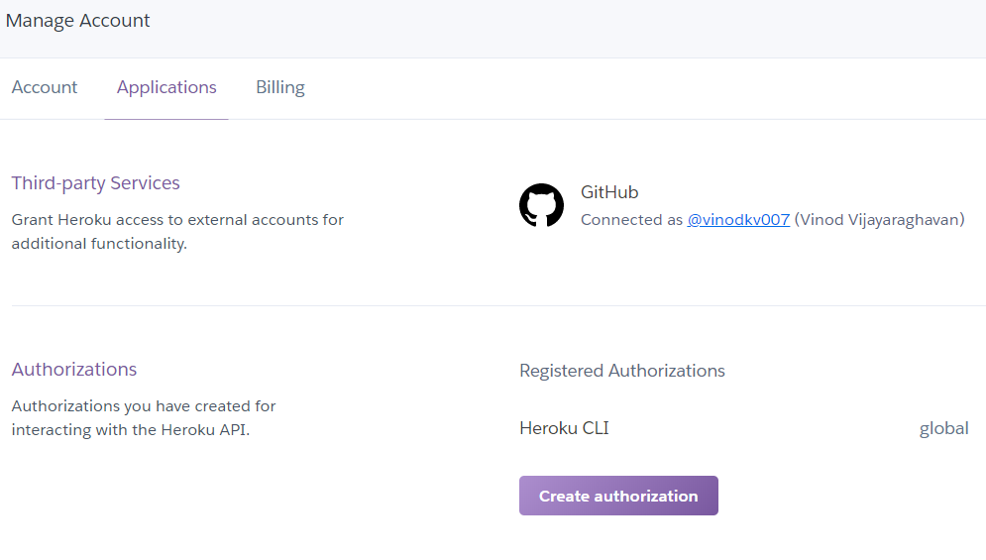
Step 6 – Link the Github to heroku

Slide 9
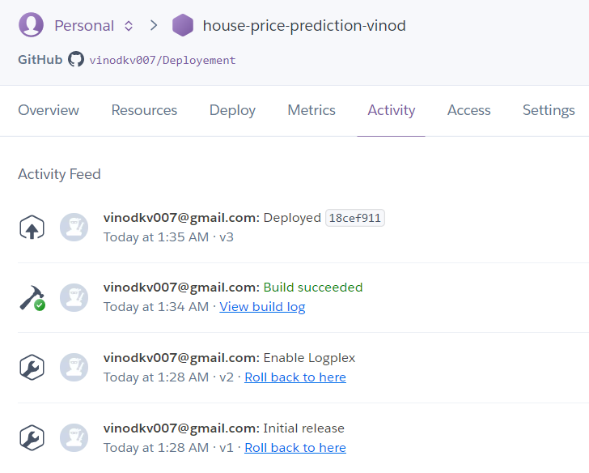
Step 7 - Deploy the model

Slide 10
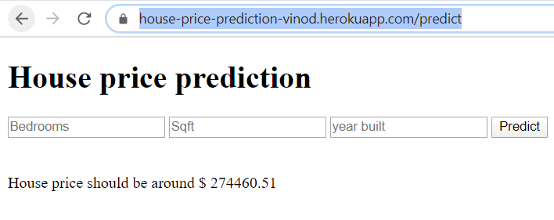
Step 8 – Web app is ready!
https://house-price-prediction-vinod.herokuapp.com/

Slide 11
Conclusion
The web app was deployed successfully and it’s functioning as expected. We chose 3 most important features for price prediction, ie Number of bedrooms, Sqft and Year built. App deployment was butter-smooth using Heroku.
It is important to deploy the app locally and make sure everything is working as expected before deploying to the cloud platform.
Overall we believe the project was a success and it delivered as expected.

